Slide 1
Web Content Workshop
How to write effectively for the web and for your audience
Notes:
Donna: overview of why they are here
Website redesign

Slide 2
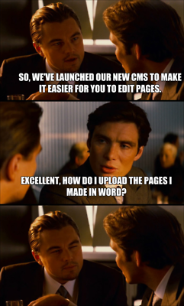

Slide 3
Areas we’ll cover today
Philosophy of user-centered content
Structuring your content and navigation
Writing for the web
Writing about Elizabethtown College
Images and other Formatting

Slide 4
User-Centered Content
All about your audience

Slide 5
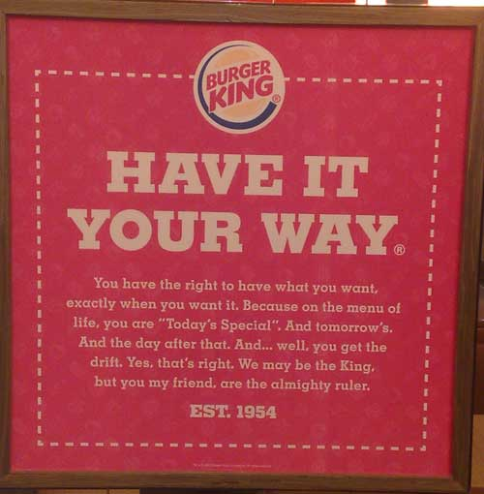
User-Centered Content
When you land on a website, you want it to be catered to your needs, right? Just like your order at Burger King.
Extra pickles. No onions.

Slide 6
Know your users in general
They are self-centered
They think differently than you
They do not care about organizational structure of the organization
They are high on expectations, low on patience
Notes:
The idea: SERVE THEM, not yourself

Slide 7
Knowing YOUR Users
Who are your users?
How would you rank them?
Why are they coming to your website?
What do you WANT them to do?
Know?
Think?

Slide 8
Classic Rock Concert Analogy
Every juke box and cover band in America can be heard playing “American Girl” or “Mary Jane’s Last Dance.”
Tom Petty & the Heartbreakers has a brand new album out which they are on tour to promote.
How does one of the most popular bands in America cater to audience needs and the ‘selfish’ intentions?

Slide 9
Aiming at your audience
Prioritize your audience
You cannot serve everyone’s needs equally on the homepage
You CAN serve all your audiences in other ways
Top-level – new visitors
Deeper – repeat visitors

Slide 10
Activity
Let’s build a sample audience matrix to demonstrate the variety of expectations.
Scenario:
We are a new, independent record label in Elizabethtown, Pa. We have signed a few artists already and are poised to grow. (Beiber who?)

Slide 11
Information Architecture and Navigation
How to organize content to best suit audience needs

Slide 12
Informational Architecture 101
Informational Architecture (IA) combines marketing, strategy and usability
Strategy – overarching goals of website
Usability – does it make sense to the end user?
Marketing – bubble up information you want users to know that they may otherwise miss
IA answers the question, “where do I go to find what I need?

Slide 13
Navigation
Navigation is your IA on display
You can use a few types of navigation to get people to the right places
Main left-hand navigation
Featured section call-outs (widgets, etc.)
Task-based navigation
Topic-based links
Audience-based links
Search box
Breadcrumbs
Links within copy

Slide 14
Navigation Examples at a Glance

Slide 15
Tips for Building a Good IA
Refer to your audience matrix – what are they looking for ?
Gather relevant information from all sources (phone calls, etc)
Sort with your users in mind
Start with general and move to specific
Separate the internal from the external
Know what other people are doing elsewhere on the website

Slide 16
Activity
Using the Audience Matrix, let’s build a quick wireframe for the homepage.

Slide 17
Writing for the Web
How to create attractive pages for web users

Slide 18
Before you write
Plan your content
Create an outline
Create a schedule
Keep content in Word docs or something like that; not only in CMS
80% of web content management is done OUTSIDE the CMS

Slide 19
The Newspaper Approach
Who, What, When, Where, Why, How
Interesting facts & stories
Least Important Info

Slide 20
Writing Tips
Write to the appropriate reading level. High school sophomore is good baseline.
Keep the tone conversational and personable. (“You” and “We” is OK!)
Avoid clichés (Click here, welcome)
Clever is not as good as clear
Make content actionable
Watch for duplicate content (use tools and resources. Ex: link to catalog)
Keep College’s key messages in mind: Surprise Yourself! Be a bigger part of the world.

Slide 21
Search Engine Optimization
Over 50% of users will use a website’s search to find a page within a site.
Remember that a majority of people will also come to an interior page directly from a Google search result, bypassing your homepage.
So – write your content with the search engines in mind.
Choose keywords that USERS use

Slide 22
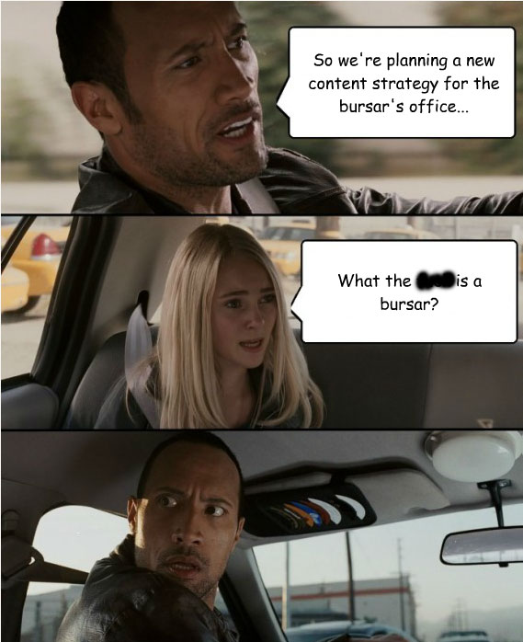

Slide 23
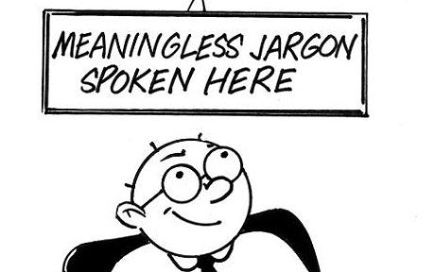
Keyword Exercise
Can you give an example of how you refer to something internally that would make little sense to an outsider.

Slide 24
SEO Continued
Good SEO comes naturally
Develop page titles that clearly and concisely explain the page – this is the detail listed in search results page
Make sure page title name matches with links to that page

Slide 25
SEO Continued
Alt Tags are crucial – every image should have an alt tag
Alt tags should convey what is in the picture, not just a random title
This is for those with visual impairments, but also helps SEO
Alt tags drive Google image search

Slide 26
Formatting Web Content
It’s more than what is said…

Slide 27
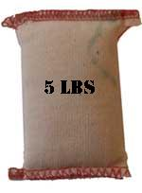
Formatting Tips for Web Writing
Think of main landing pages as a billboard or full-page ad –details at a glance.
Keep paragraphs and sentences short
Remember the navigation!
Use formatting to break up text
Bulleted Lists
Subheadings
Images
We’ll talk more about this later…
Link phrases, not words
Scrolling is OK – but give clues that there is more content below

Slide 28
Web No Nos
Word Documents
There are many reasons, including SEO
Brochures
There are many reasons, including format
Cliches
Click here
Welcome
Coming soon and under construction
Don’t overformat
Watch pasting from Word
Watch language when pasting from another document (ex: “visit this website”)

Slide 29
Images
Images are part of web content even though they are not text
Pictures
Graphics (icons, logos, etc.)
Images should be meaningful to content
Images need to be properly sized (file size, not just ‘resized’) before uploading into any CMS
Load time
Quality – squishy and grainy!

Slide 30
Other Page Elements
Page formatting
Bulleted lists
Block quotes
DIV styles
Etc.
College CMS has built in ‘shortcuts’ to formatting under ‘snippets’ – for other CMSs, there are tutorials (WordPress, etc.)
Video embed (YouTube)
Photo Slideshow embed (Flickr)

Slide 31
Activity
Let’s look at a cluttered homepage and section page and see how we can fix these so they are up to par with best practices.
What would you suggest for this page?

Slide 32
Questions?
What questions do you have about writing for the web?
Resources in my public folder.

