Slide 1

asdf
Elizabethtown College

Slide 2
Why?
Great institutions plan boldly:
“Nothing happens unless
first a dream”
—Sandburg

Slide 3
Why now?
Turning point in College’s history
New economic situation
New competition
New media, new generation, new needs
Need to be distinctive

Slide 4
What kind of plan?
Relatively short
Comprehensive
Measureable goals
Used by units
Built-in review mechanism
3-5 year horizon with 10 year vision
Built on lots of input and discussion
Based on our mission

Slide 5
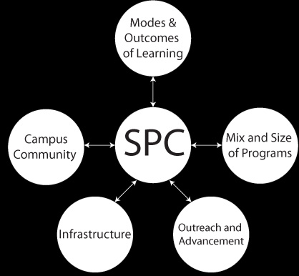
Strategic Planning Committee (SPC)
& Five Working Groups
12-member SPC with 60-70 people in groups

Slide 6
Timeline
Sept.-Nov.-Information gathering & discussion
Dec. 1-Working Groups’ reports due
Jan.- Campus Workshop on First Draft
Mar.- Meetings on Second Draft
April- Third Draft for adoption
Written version early followed with debate
“We don’t make decisions, we approve language.”—Sanderson

Slide 7
An opportunity
Strategic planning can provide:
Renewed sense of common mission
Fuller education for our students
Wiser use of resources
Stronger bonds with alumni and the region
Opportunity to shape the future

Slide 8
What Can You Do?
Volunteer to serve
Help compile group’s thoughts and send to the SPC
Share your individual comments
Point out models we should emulate
React to the 1st and 2nd drafts of the Plan
Help shape the future!

