Slide 1

Starfish at Elizabethtown college

Slide 2


What is starfish?
Starfish is a software tool that enhances advising relationships and student success at Elizabethtown College. Faculty, staff and students connect through a network of information and services.
Learn More, Earlier, About Your Students
Faculty and staff can easily view students’ progress toward academic goals, identify road blocks to success and intervene when students are struggling.
Make it Easy for Students to Engage
Students receive real time feedback, encouragement, and acknowledgement through flags and kudos.
Notes:
Tailor your talking points based on your particular Starfish licenses and the benefits of each solution that most appeal to your audience

Slide 3
Today’s Purpose
5 Quick Tips for Starfish Usage
Calendar Integration
Utilizing Starfish to Inform Advising
Closing the Loop

Slide 4
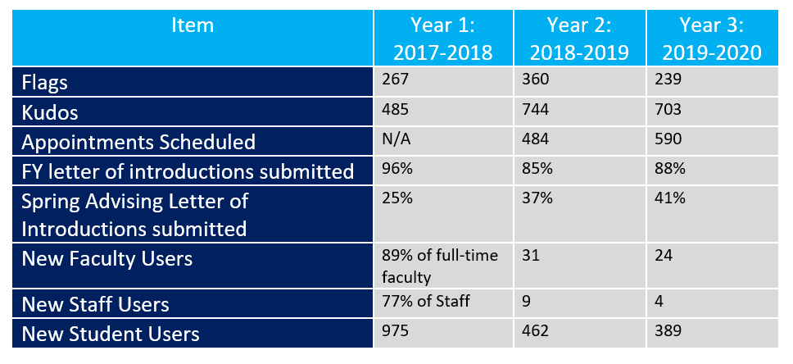
YEAR 1, YEAR 2 & YEAR 3 COMPARISIONS

Slide 5
How does Elizabethtown College utilize Starfish ?
Potential Withdrawal/Transfer
Schedule an appointment with Advisor/Instructor (590 appointments made)
Raise your Hand feature
Modules Incomplete
Course Withdrawal System Flag
Transfer Student Success Plans
Letter of Introduction & Major & Career Reflection
Immediate intervention can occur by various individuals such as Coaches, Honors Program Advisor, Momentum Advisor, etc.
Center for Student Success provides reach out to:
  Students with multiple flags
  Students on probation
  Students who receive a flag in FYS or English 100
  Students who receive a flag in 300/400 level courses
  Students who earned D/F or withdrew from course previously

Slide 6
5 Quick Tips for Starfish
1. Set up your Profile & Calendar Integration
2. Feedback Fridays
  Select a day of the week to log onto Starfish and provide feedback to students
3. Student Facing comments
  Remember that the most effective comments are student facing and use growth mindset language.
4. Use Starfish to prepare for advisement
  Log in and check a students courses and any flags/Kudos
5. Close the Loop

Slide 7
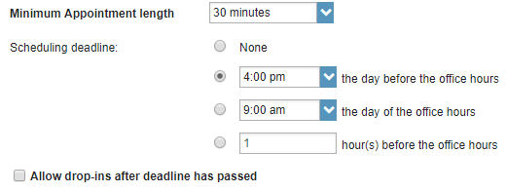
Setting up Calendar Integration
Select “Appointment Preference” from your profile. Chose a minimum appointment length and schedule a deadline.
Note: Scheduling deadlines do not allow students to schedule a time with you after a certain time on the day before your office hour or at a certain time on the day of your office hour. (In the example below students are unable to schedule an appointment with this advisor after 4pm the day before the office hour.)

Slide 8

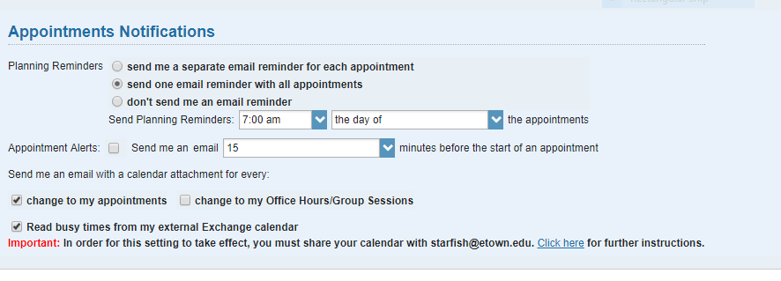
Add a location:
Click and add your location, enter any instructions such as “Please check in at the front desk” etc. Please do NOT add any Calendar Managers at this time.
Email Notifications
Click on “Email Notifications” and in the “Appointments Notifications” box select how you would like to receive your email reminders regarding appointments and if you would like email alerts 15 or more minutes prior to your appointment. Select if you would like an email with a calendar attachment for every change to my appointment. We do NOT recommend receiving a calendar attachment for every change to your office hours’/group session.

Slide 9
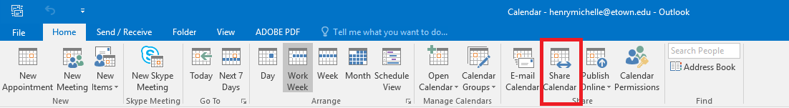
In order to read the busy times off of your outlook calendar, select “Read busy times from my external Exchange calendar”. IMPORTANT: You will need to share your calendar with starfish @etown.edu for this to be in effect. To share your calendar, follow the directions from the link in the Appointments Notifications box or…
In your Outlook calendar, select “Share Calendar”

Slide 10
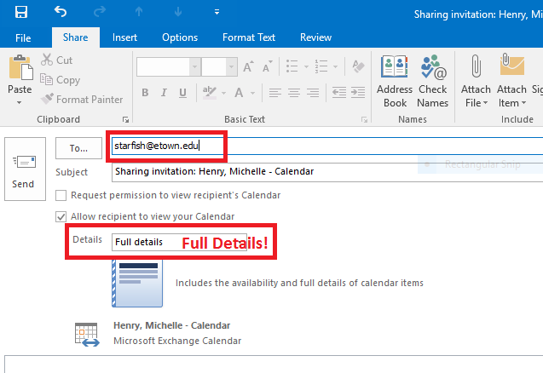
Enter the starfish@etown.edu email address in the To: line and select “Full Details”. *Note: Full details must be selected for this to work properly. Click send.

Slide 11
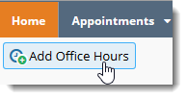
Office Hours
Select Add Office Hours near the top left under the Home tab to create a single or recurring set of office hours.
Tips on completing the Add Office Hours form:
Title: Displays on your calendar to distinguish sets of office hours.
Where? - Type: Options include in an office, on the phone or online, for example.
Office hours Type: Options include scheduled, walk-ins or both.
Start/End Date Tab: Select end date as “End of Term” then select term from dropdown list.
Important Note: Once an office hour block is saved, you will not be able to edit weekdays on which it occurs or type of frequency (e.g. weekly).
Click submit.

Slide 12
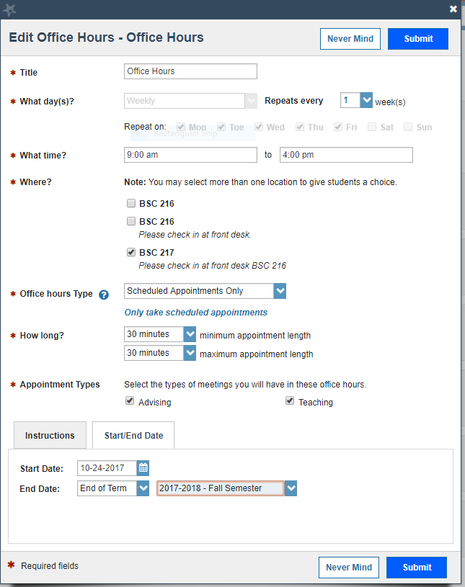

Slide 13
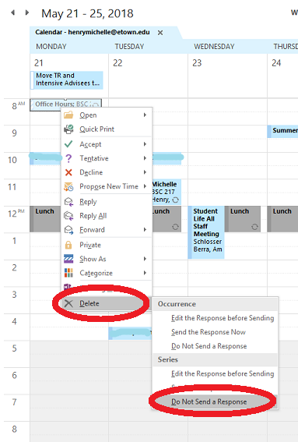
Go back to Outlook calendar and find Office Hour blocks on calendar. Right Click, select “Delete” under Series event, “DO NOT SEND A RESPONSE” .

Slide 14
Utilizing Starfish to Inform Advising
Select a student from your “Students” section of Starfish
View their profile
  Do they have any additional contact information listed?
Discover what courses they are enrolled in.
What courses did they take in the past?
  Did they withdrawal from any courses in the past?
Review active and resolved flags and Kudos
  Do you notice any trends?
View their success network
  Are they an athlete, a member of a group (Honors/Momentum)
Review their letter of introduction or Major & Career Reflection Activity if applicable.

Slide 15
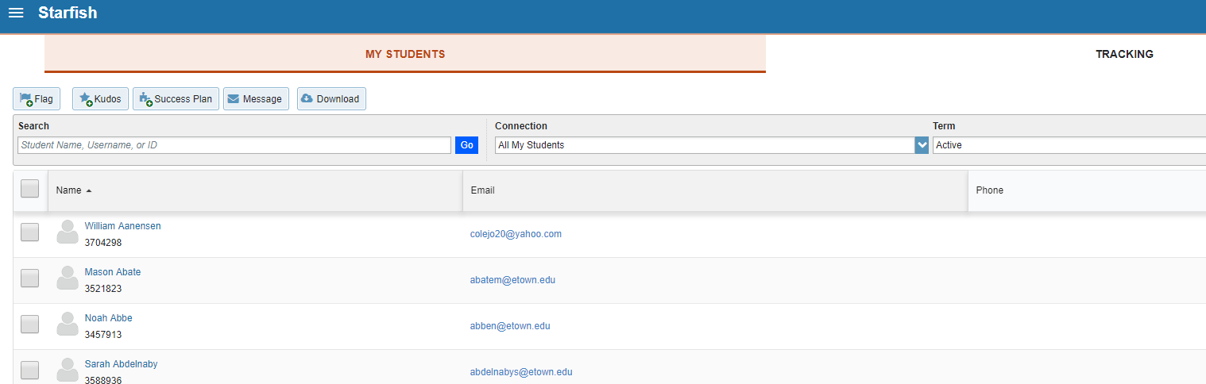
Navigating your student list
Select Students name to view profile

Slide 16
Student Facing Comments
Address the student
State your concern
Provide any data
Close by offering support and asking student to be in touch
Use positive growth mindset language throughout
Example:
  Michelle, I’m concerned about your attendance and progress in this course, we’ve missed you the last 3 classes. Please be in touch with me, I want you to be successful.
  Michelle, I’m checking in because it’s now been 3 classes since I last saw you and you missed our chapter 4 quiz today. I’m reaching out to confirm if you are still planning on taking the class, if you need any additional support, and if there are any barriers to you participating at this time. Please let me know how I can support you and aid in your success.

Slide 17
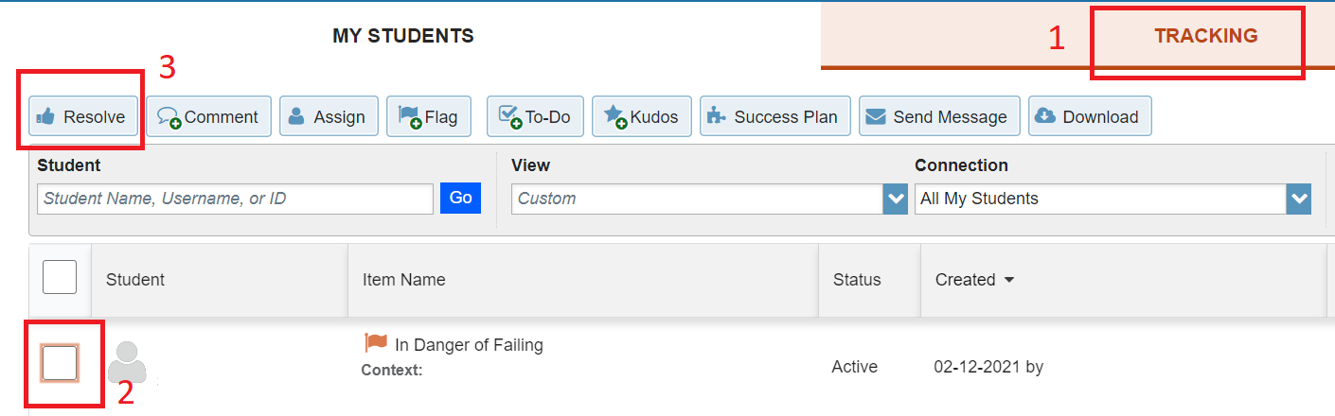
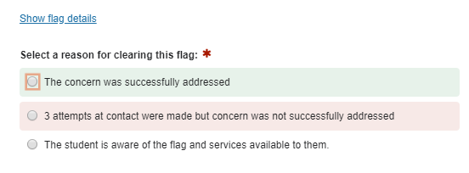
Resolving a flag & Closing the Loop
To resolve a flag, go to “Students”, “Tracking”, Select the box next to the name of the student and flag/Kudo you want to resolve and then select “Resolve”.
You will have options for why you’d like to Close this flag and the ability to enter comments if you wish.

Slide 18
Resources & Support
Etown Website & Newsletters:
http://www.etown.edu/offices/advising/starfish.aspx
Within Starfish:
  Help Menu in upper right next to your name
  Help Library links to help guides with step-by-step instructions for everything Starfish
For additional support, contact starfish@etown.edu
Notes:
List resources you plan to offer end users

