Slide 1
INTERVIEWING SKILLS Career Services, BSC 2nd Floor

Slide 2
Interview Prep
Conduct Company Research prior to interview
Online: company website and www.wetfeet.com, www.rileyguide.com/employer.html
Corporate culture, dress, environment, etc.
Must be able to answer the questions, “What do you know about our organization?” and “Why do you want to work here?”
Make sure you know the route!!

Slide 3
What to Wear
Plan your interview attire well in advance
Dress for the position, but when in doubt, go with professional and conservative!!
Some good info online at http://www.symsdress.com
Career Spots “Interview Dress for Men” & “Interview Dress for Women” add links

Slide 4
Types of Interviews
Phone
Skype/webcam, Interview stream
In person
individual
group
panel
behavioral/situational

Slide 5
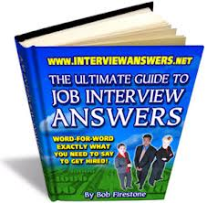
Interview Questions
Prior to interview, develop a list of accomplishment stories that highlight your skills.
Be prepared to answer general questions regarding your background, your education, and if you would be a good fit for the position.
Be prepared to answer hypothetical or case questions specific to your field.
PRACTICE, PRACTICE, PRACTICE!!!
On your own
With peers
Mock Interviews
Add Career Spots link to “behavioral Interviewing

Slide 6
Interview Day
Arrive early (10 – 15 minutes is best)
Remember you are “on” from the minute you arrive at the site (be polite to everyone!)
Firm handshake
Listen/be attentive (body language)
Let your personality show
Be prepared to talk about your abilities & experience—why should they hire you??

Slide 7
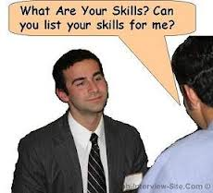
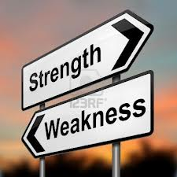
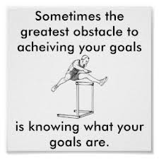
Questions to Prepare for
Tell me about yourself
Strengths & weaknesses
Goals/career plans
Why should I hire you?

Slide 8
What employers are looking for
Aptitude: Can you do the job (do you have the necessary skills)?
Personality: Are you someone who will fit in well to this work environment? Do I (we) want to work with you?
Experience: Discuss Leadership examples – groups, activities, job & volunteer experience

Slide 9
Questions for Employers
What do you want or need to know about the organization to help you make your decision?
Ask questions that demonstrate your interest in contributing to the organization, rather than asking what they can do for you.
Process questions (what happens next?)
Closing the interview: make sure to thank the interviewer for her or his time!! Follow up with a thank you within 24- 48 hours!

Slide 10
Preparing for Mock Interviews
Link to mock interview questions coming soon

